Slide 1
"Unit 13: "For Live Session"
Chad Madding

Slide 2
In preparation for the live session, please complete the following and submit your PowerPoint. Be sure and submit your work to the "Unit 13: "For Live Session" Assignment" assignment on 2DS.
1. Model the sunspot/melanoma data with a MLP. Use the model to provide eight-step-ahead forecasts. Finally, calculate the ASE, and compare your NN model to the VAR model we estimated previously.
2. Model the Schumway pollution data with a MLP model, and provide 10-step-ahead forecasts. Calculate the ASE, and add your analysis to a slide in your Unit 13 For Live Session PowerPoint deck.
3. Model your time series with a MLP, and compare it with ARMA/ARIMA models you have fit to it in the past.
Don't forget to make your last slide(s) your Key Takeaways and any questions you may have!

Slide 3
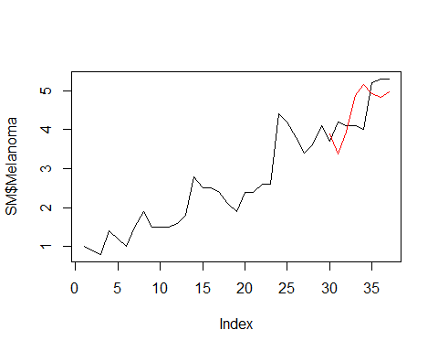
1. Model the sunspot/melanoma data with a MLP. Use the model to provide eight-step-ahead forecasts. Finally, calculate the ASE, and compare your NN model to the VAR model we estimated previously.
VAR Model Forecasts Seasonally Differenced Data
SM = read.csv('Melanoma_Sunspot.csv',header = TRUE) SMsmall = SM[1:29,] VAR_SM = VAR(cbind(SMsmall$Melanoma,SMsmall$Sunspot),lag.max = 5, type = "both")
pred = predict(VAR_SM,n.ahead = 8) plot(SM$Melanoma, type = "l") lines(seq(30,37,1),pred$fcst$y1[,1],col = "red")
#Read in the data SM = read.csv('Melanoma_Sunspot.csv',header = TRUE) SMsmall = SM[1:29,] SMsmallDF = data.frame(Sunspot = ts(SMsmall$Sunspot)) fit.mlp = mlp(ts(SMsmall$Melanoma),reps = 50,comb = "mean",xreg = SMsmallDF) fit.mlp
## MLP fit with 5 hidden nodes and 50 repetitions. ## Series modelled in differences: D1. ## Univariate lags: (1,2,3) ## 1 regressor included. ## - Regressor 1 lags: (1,2,3) ## Forecast combined using the mean operator. ## MSE: 0.0019.
plot(fit.mlp)
SMDF = data.frame(Sunspot = ts(SM$Sunspot)) fore.mlp = forecast(fit.mlp, h = 8, xreg = SMDF) plot(fore.mlp)
plot(SM$Melanoma, type = "l") lines(seq(30,37,1),fore.mlp$mean,col = "blue")
ASE_SM_NN = mean((SM$Melanoma[30:37] - fore.mlp$mean)^2) ASE_SM_NN
## [1] 0.06522867
ASE_SM_VAR = mean((SM$Melanoma[30:37] - pred$fcst$y1[1:8])^2) ASE_SM_VAR
## [1] 0.3867062

Slide 4
2. Model the Schumway pollution data with a MLP model, and provide 10-step-ahead forecasts. Calculate the ASE, and add your analysis to a slide in your Unit 13 For Live Session PowerPoint deck.
VAR Model 3 seasonal with Lag 1 Temp
#Lag the temp data one CM$temp_1 = dplyr::lag(CM$temp,1)
#Forcast out? CMForcast = 10 #Read in the data CM = read.csv('LA_Cmort_Study.csv',header = TRUE) #get the total rows CMRows = nrow(CM) CMsmall = CM[1:(CMRows-CMForcast),] CMsmallDF = data.frame(Week = ts(CMsmall$Week),temp = ts(CMsmall$temp), part = ts(CMsmall$part), temp = ts(CMsmall$temp)) fit.mlp1 = mlp(ts(CMsmall$cmort),reps = 50,comb = "mean",xreg = CMsmallDF) fit.mlp1
## MLP fit with 5 and 50 repetitions. hidden nodes ## Univariate lags: (1,2) ## 3 regressors included. ## - Regressor 1 lags: (1) ## - Regressor 2 lags: (1,2,4) ## - Regressor 3 lags: (2,4) ## Forecast combined using the mean operator. ## MSE: 17.986.
CMDF = data.frame(Week = ts(CM$Week),temp = ts(CM$temp), part = ts(CM$part), temp = ts(CM$temp)) fore.mlp1 = forecast(fit.mlp1, h = CMForcast, xreg = CMDF)
ASE_CM_NN = mean((CM$cmort[((CMRows-CMForcast)+1):CMRows] - fore.mlp1$mean)^2) ## [1] 29.75473
VARselect(cbind(CM$cmort[2:508], CM$part[2:508], CM$temp[2:508]),lag.max = 10, season = 52, type = "both")
#VAR with p = 2 (Integer for the lag order (default is p=1)) CMortVAR = VAR(cbind(CM$cmort[2:508], CM$part[2:508], CM$temp[2:508]),season = 52, type = "both",p = 2)
preds=predict(CMortVAR,n.ahead=30)
#Find ASE using last 30 CMsmall = CM[1:478,] #Start and 2 since the lagged variable is NA at first index VARselect(cbind(CMsmall$cmort[1:478], CMsmall$part[1:478], CMsmall$temp[1:478]),lag.max = 10, season = 52, type = "both")
CMortVAR = VAR(cbind(CMsmall$cmort[1:478], CMsmall$part[1:478], CMsmall$temp[1:478]),season = 52, type = "both",p = 2)
preds=predict(CMortVAR,n.ahead=30) ASE_CM_VAR = mean((CM$cmort[479:508] - preds$fcst$y1[,1])^2) ASE_CM_VAR
## [1] 40.86571

Slide 5
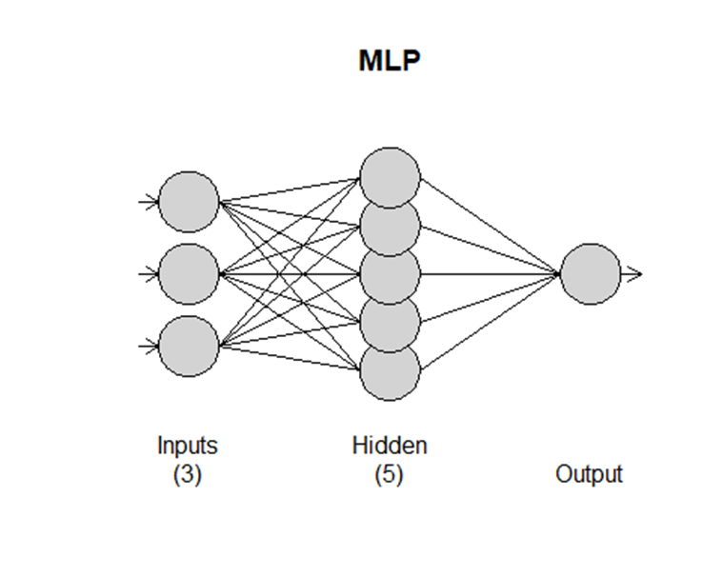
3. Model your time series with a MLP, and compare it with ARMA/ARIMA models you have fit to it in the past.
SMUForcast = 48 #Read in the data SMU = read.csv('DedmanHourleySwipe.csv',header = TRUE) #Just using Feb. 11th to March 11th 2020 data SMU = SMU[5891:6360,] #get the total rows CMRows = nrow(SMU) SMUsmall = SMU[1:(CMRows-SMUForcast),] ggpairs(SMU[c(2,10,17,18)])
SMUsmallDF = data.frame(Temperature = ts(SMUsmall$Temperature), Humidity = ts(SMUsmall$HourlyRelativeHumidity),Hour = ts(SMUsmall$Hour)) fit.mlp = mlp(ts(SMUsmall$IDSwipes),reps = 10,comb = "mean",xreg = SMUsmallDF)
## MLP fit with 5 hidden nodes and 10 repetitions. ## Univariate lags: (1) ## 3 regressors included. ## - Regressor 1 lags: (1,3,4) ## - Regressor 2 lags: (1,3,4) ## - Regressor 3 lags: (1,3) ## Forecast combined using the mean operator. ## MSE: 339.4174.
plot(fit.mlp)
SMUDF = data.frame(Temperature = ts(SMU$Temperature), Humidity = ts(SMU$HourlyRelativeHumidity), Hour = ts(SMU$Hour)) fore.mlp = forecast(fit.mlp, h = 48 , xreg = SMUDF) ASE_SMU_NN = mean((SMU$IDSwipes[((CMRows-SMUForcast)+1):CMRows] - fore.mlp$mean)^2) ASE_SMU_NN
## [1] 977.3788

Slide 6
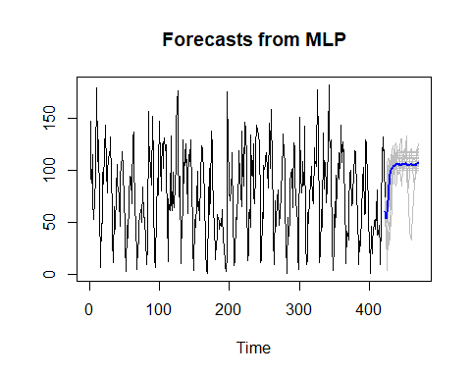
3. Model your time series with a MLP, and compare it with ARMA/ARIMA models you have fit to it in the past.
SMU data NN using the default settings.
fit.mlp = mlp(ts(SMUsmall$IDSwipes)) fit.mlp
## MLP fit with 5 hidden nodes and 20 repetitions. ## Univariate lags: (1,2,4) ## Forecast combined using the median operator. ## MSE: 667.1125.
fore.mlp = forecast(fit.mlp, h = 48) plot(fore.mlp)
ASE_SMU_NNid = mean((SMU$IDSwipes[((CMRows-SMUForcast)+1):CMRows] - fore.mlp$mean)^2) ASE_SMU_NNid
## [1] 2118.391

Slide 7
3. Model your time series with a MLP, and compare it with ARMA/ARIMA models you have fit to it in the past.
#VAR SMForcast = 48 SM = read.csv('DedmanHourleySwipe.csv',header = TRUE) #Just using Feb. 11th to March 11th 2020 data SM = SM[5891:6360,] #Just using March 1st to March 11th 2020 data #SM = SM[6189:6360,] #get the total rows SMRows = nrow(SM) SMsmall = SM[1:(SMRows-SMForcast),] #VAR Model 3 seasonal with Lag 1 Temp SMsmall$temp_1 = dplyr::lag(SMsmall$Temperature,1) VARselect(cbind(SMsmall$IDSwipes[1:(SMRows-SMForcast)], SMsmall$Temperature[1:(SMRows-SMForcast)], SMsmall$HourlyRelativeHumidity[1:(SMRows-SMForcast)],SMsmall$Hours[1:(SMRows-SMForcast)]))
VAR_SM = VAR(cbind(SMsmall$IDSwipes[1:(SMRows-SMForcast)], SMsmall$Temperature[1:(SMRows-SMForcast)], SMsmall$HourlyRelativeHumidity[1:(SMRows-SMForcast)],SMsmall$Hours[1:(SMRows-SMForcast)]))
## Warning in VAR(cbind(SMsmall$IDSwipes[1:(SMRows - SMForcast)], SMsmall$Temperature[1:(SMRows - : No column names supplied in y, using: y1, y2, y3, y4 , instead.
pred = predict(VAR_SM,n.ahead = SMForcast)
## Warning in summary.lm(x): essentially perfect fit: summary may be unreliable
while (!is.null(dev.list())) dev.off() plot(SM$IDSwipes, type = "l") lines(seq((SMRows-SMForcast)+1,SMRows,1),pred$fcst$y1[,1],col = "red") ASE_SMU_VAR = mean((SM$IDSwipes[((SMRows-SMForcast)+1):SMRows] - pred$fcst$y1[1:SMForcast])^2) ASE_SMU_VAR
## [1] 1773.196

Slide 8
Key Takeaways / questions
The main question/problem I have this week is about getting the graph and ASE correct.
I am having problems seeing how to cut up the data for:
testing/training
Graphing
Getting the correct ASE
Would you please show how to property cut up the data then show how each piece is used then show how they correspond on the graphs?

